Slide 1
Get started with Microsoft 365 Copilot Chat

Slide 2
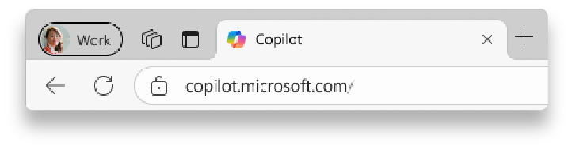
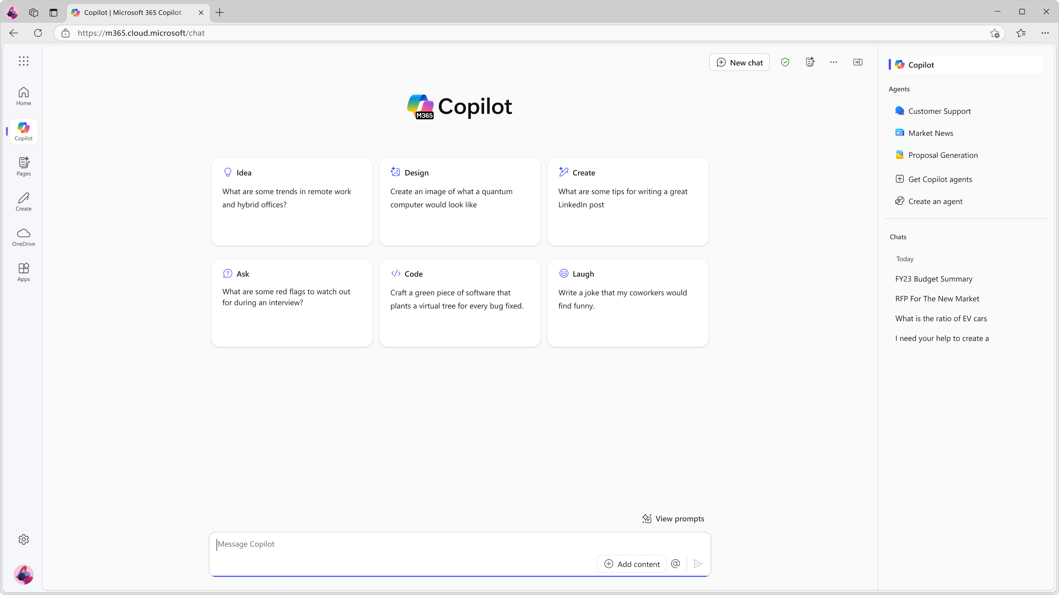

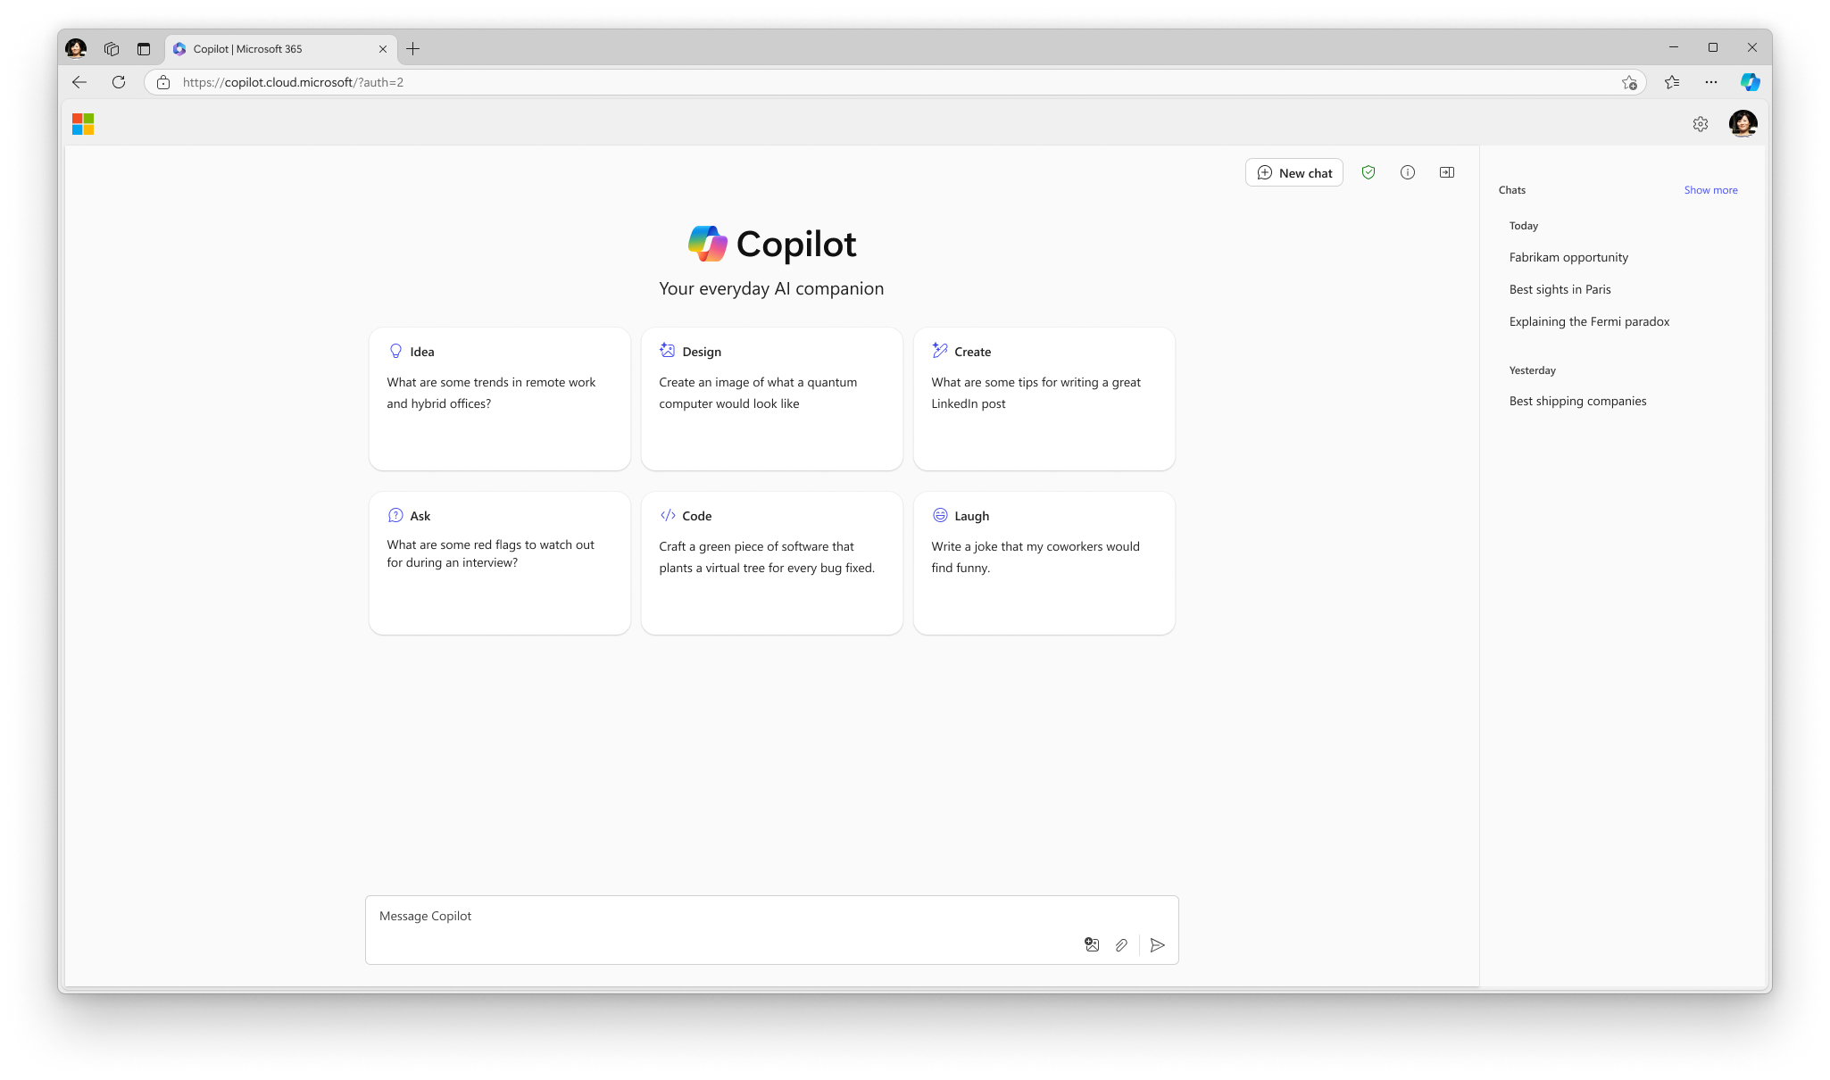

Sign in with your work account
1
2
1
Navigate to M365Copilot.com on your preferred browser on your device to get to Copilot Chat.
https://M365Copilot.com
2
Ensure you’re signed in with your work account.
You will know you are successfully signed in to Copilot Chat when you see the green shield icon next to “New chat” and the Microsoft 365 Copilot icon at the top of the page.
If you are not signed in with your work account, Enterprise Data Protection does not apply.

Slide 3
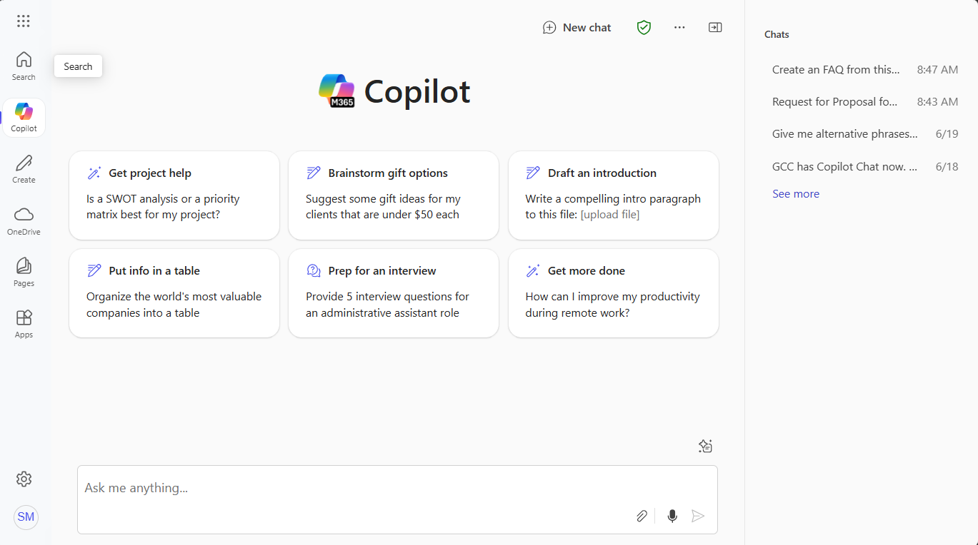
Get to know Copilot Chat Today!
Start at
M365Copilot.com
Here is a visual tour of Copilot Chat:
Start a new chat button
Clear your past chat and start a new conversation.
Recent chats
Return to a previous chat to continue the conversation
Suggested prompts
If you’re not sure what to ask, try or modify a sample prompt!
Copilot Prompt Gallery
View additional prompt suggestions, including saved prompts.
Prompt box
Start your conversation here.
Send your prompt!
Upload files
If you’d like Copilot to source responses from information in specific files, add them here.

Slide 4



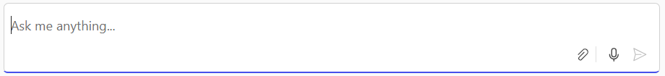

How to chat in 3 steps
1. Enter your prompt
2. Check sources
3. Continue the conversation
Enter your detailed prompt in the text box at the bottom. If you would like Copilot to source information from any reference files, you can upload them in your prompt by selecting the paperclip icon.
Copilot Chat is transparent about the sources of its information. See these sources listed underneath the answer.
Vet these sources and validate your answers.
You can ask follow-up questions as you would in a conversation. You can refine the answer too.
For example, try “Write a shorter answer" or "Give me more detail." You can also select suggested prompts.

Slide 5
Writing an effective prompt
Context
Goal
To get the best response, it’s important to focus on some of the key elements when phrasing your Copilot prompts.
Why do you need it and who is involved?
What response do you want from Copilot?
I work in public service and focus on making my community stronger. Give me a concise summary of recent news about [my municipality]. Focus on web articles from the last 2 months. Provide the answer in two to three paragraphs and use a business tone.
Which information sources or samples should Copilot use?
How should Copilot respond
to best meet your expectations?
Source
Expectations

Slide 6
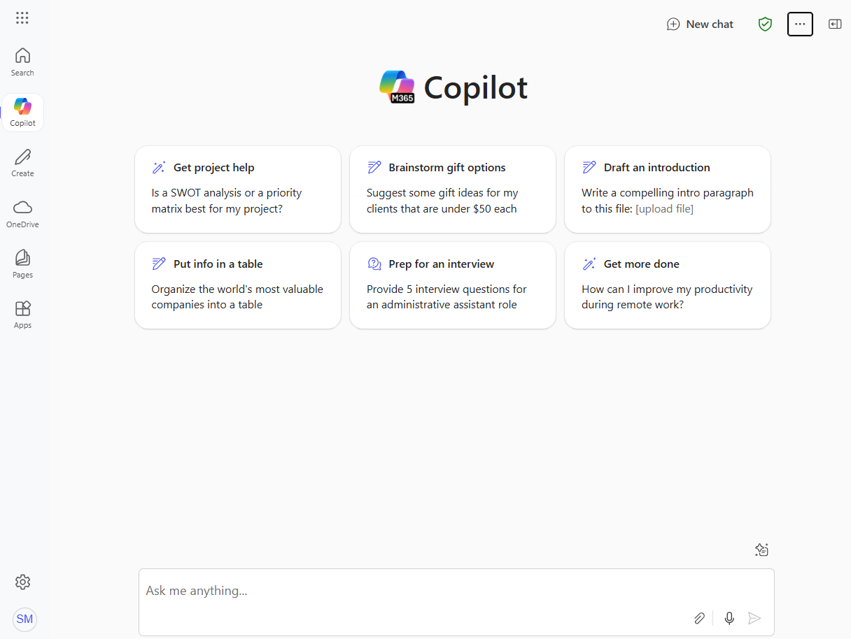
Upload a file to your prompt
Want Copilot to respond using information from a Word document, PowerPoint deck, or other file? Select the paperclip icon in the Copilot Chat prompt box to upload a file.
Example prompt: Summarize this document in 5 bullet points. <attach file>
Note: Copilot Chat supports uploads of Word documents, PowerPoint decks, Excel spreadsheets, and PDFs. (Image files coming soon)

Slide 7
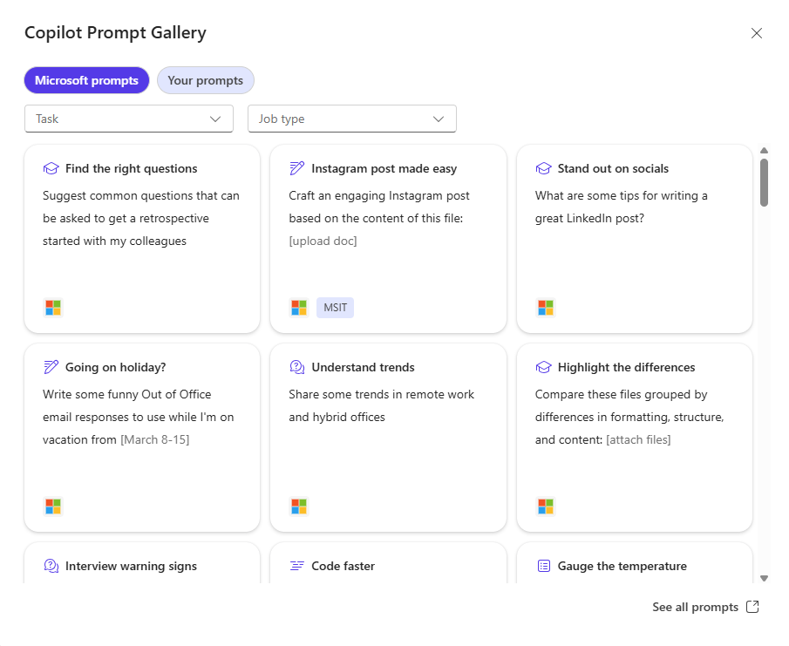

Discover and share Copilot prompts
Copilot Prompt Gallery helps you find prompting inspiration so you can take greater advantage of Copilot in your daily work.
Explore the curated selection of Copilot prompts
Save your favorite prompts
Share links to your favorite prompts with colleagues
Find prompting inspiration from others
Access the Prompt Gallery in Copilot Chat by selecting the box with star icon next to the prompt box. Here, you’ll see suggested Copilot prompts and your saved prompts.

Slide 8

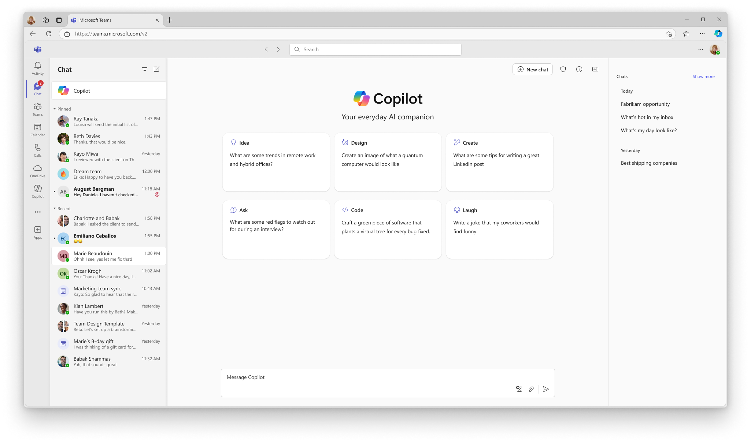
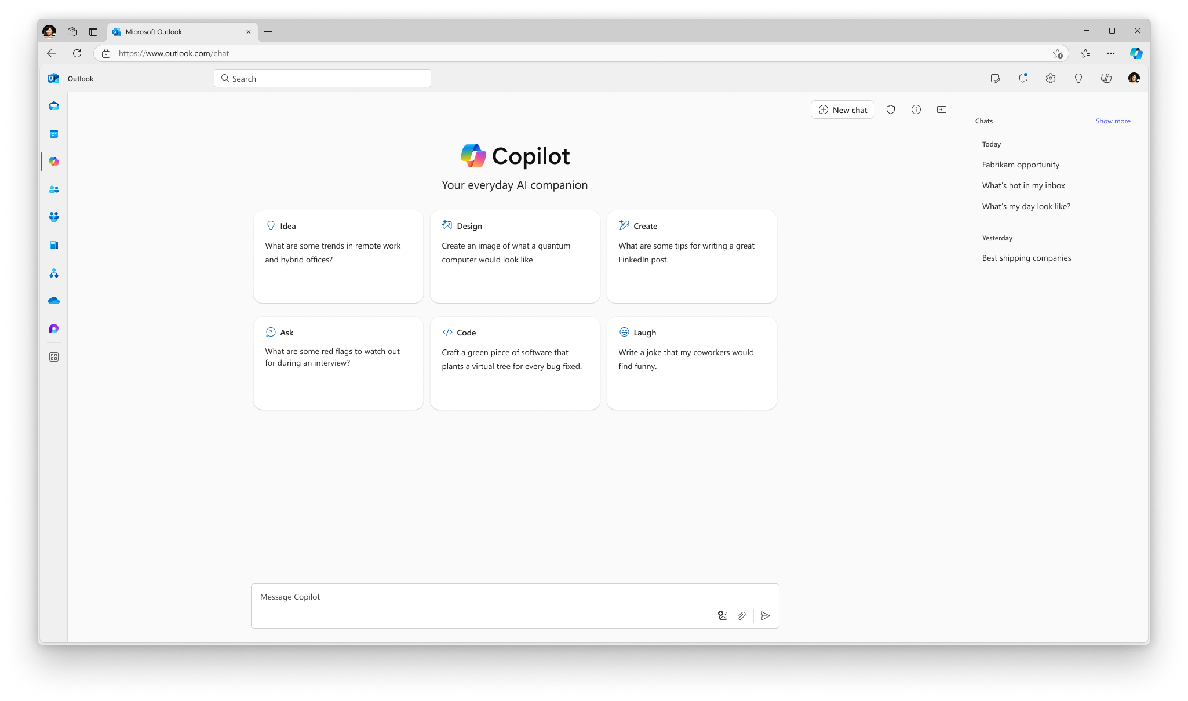
Access Copilot Chat from where you’re working
Admin note: The Microsoft 365, Outlook, and Teams app Copilot experiences will only available if Copilot is pinned by the user or admin. Instructions on how to pin Copilot for your organization can be found here.
M365Copilot.com
Teams app*
Outlook app*
*Ensure Copilot is pinned to your left navigation across Teams, Outlook, and the Microsoft 365 app.

Slide 9
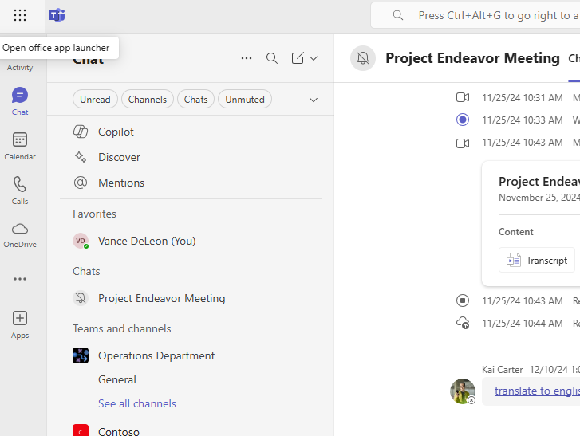
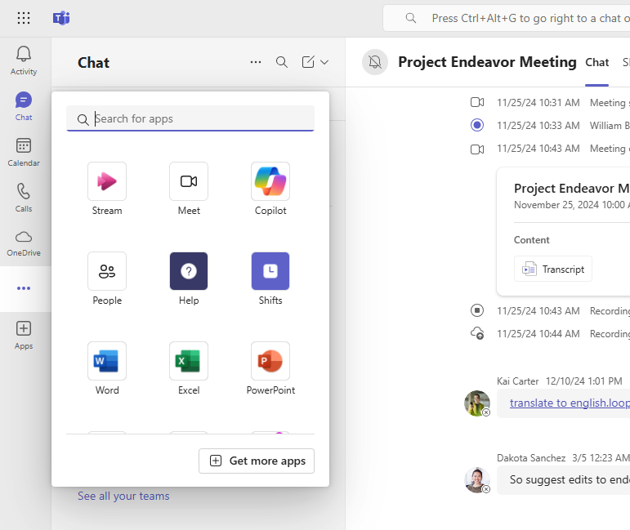
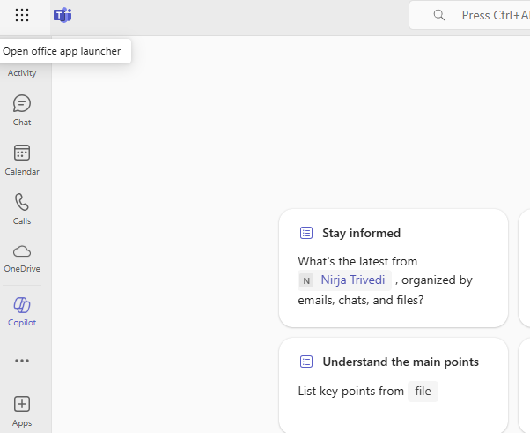
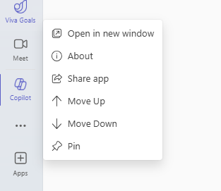
Pin Copilot Chat in your Teams app
1. Select the ellipses in the left sidebar in the Teams app to open the app library.
2. Select Copilot to open Copilot Chat. Or, type Copilot in the search bar.
3. Right click on Copilot in the left sidebar in the Teams app.
4. Select “Pin” to pin Copilot Chat to the sidebar for easy access.

Slide 10
Prompt Examples - Get the answers you need
Get hiring tips
Retrieve buried info
How can I evaluate an interview candidate’s soft skills?
What are the deadlines mentioned in this file? <attach file>?
Summarize a file
Boost your knowledge
Summarize this document in 5 bullet points. <attach file>
Help me learn about [topic]. Provide 2 analogies & files to dig in.
Start your research
Highlight the differences
How have world literacy rates changed in the past 30 years?
Compare these two paragraphs grouped by differences in formatting, structure, and content: [paste content]
Calculate the answer quickly
Monitor your PR
At $X per unit, how many units to break even if costs are $Y
Give me a concise summary of recent news about [company]
Reach a broader audience
Stay on top of tech advances
How do you say [thank you for your time] in Japanese?
Summarize the main points of the latest research on AI
Discover synonyms
Make informed decisions
What are some other words for [exciting]?
Create a table that compares top-selling office printers
Understand trends
Make your code better
Share some trends in remote work and hybrid offices
Optimize and fix this code: [insert code]

Slide 11
Prompt Examples - Brainstorm and draft content
Co-create with Copilot
Start a conversation
Ask me 3 questions to help me draft an email about [OKRs]
Suggest ways to break the ice with my new colleague.
Going on holiday?
Jump-start a draft
Write some funny Out of Office email responses.
Create an FAQ based on this file <attach file>
Make it stand out
Draft an introduction
Suggest a few email subjects for the following email: [body]
Write a compelling intro paragraph for this speech <attach file>
Generate ideas
Make it better
List ideas for a fun remote team building event
Improve my writing in: <attach file>
Put info in a table
Disagree gracefully
Organize the world’s most valuable companies into a table
Provide a convincing counterargument to the following: [paste content]
Visualize the data (pending release of Image creation to GCC)
Rally the team
Create an image of a bar chart demonstrating growth
Draft an exciting email … using <attach files>
Track changes over time (pending release of Image creation to GCC)
Get started on a plan
Create a line chart showing the relationship between…
Draft a business plan based on [idea]

Slide 12
FAQ
Why is data protection important when using AI chat tools at work?
Company data and intellectual property are crucial to our competitive advantage. The problem with using generative AI without enterprise data protection is that prompts or content you generate can be exposed to the public as part of another answer. That’s where Copilot Chat comes in: it’s protected with enterprise data protection, so what you put in and get out is not used to train the underlying AI model. Our company data stays safe.
How do I know I’m using Copilot Chat with Enterprise Data Protection?
You’ll know you’re using Copilot Chat with Enterprise Data Protection if you see a green shield icon next to the “New chat” button.
Can I trust the answers generated when using AI?
Copilot Chat aims to base all its responses on reliable sources, but AI can make mistakes, and third-party content on the internet may not always be accurate or reliable. Copilot will sometimes misrepresent the information it finds. This is why Copilot is transparent and shows the sources of information behind its answers. Always check the sources before making decisions or taking actions based on

Slide 13
FAQ Continued
What can Copilot Chat access when I use it?
Copilot Chat leverages the latest web information to respond to your prompts. It does not have access to data from your device or your organization's information. You will need to use an agent to access work data. When using Copilot Chat in the Microsoft Edge sidebar, you can grant it permission to view content on your current page to generate summaries. However, Copilot Chat will not access or use other browser data, such as your browser history.
Are there limits for how much I can use Copilot Chat?
As with other AI tools, there are limits to how many turns (prompts and responses) you can do per chat conversation and per day. If you reach those limits, you will be notified within the experience. There are also limits for certain capabilities in Copilot Chat, like uploading files and generating images.

Slide 14
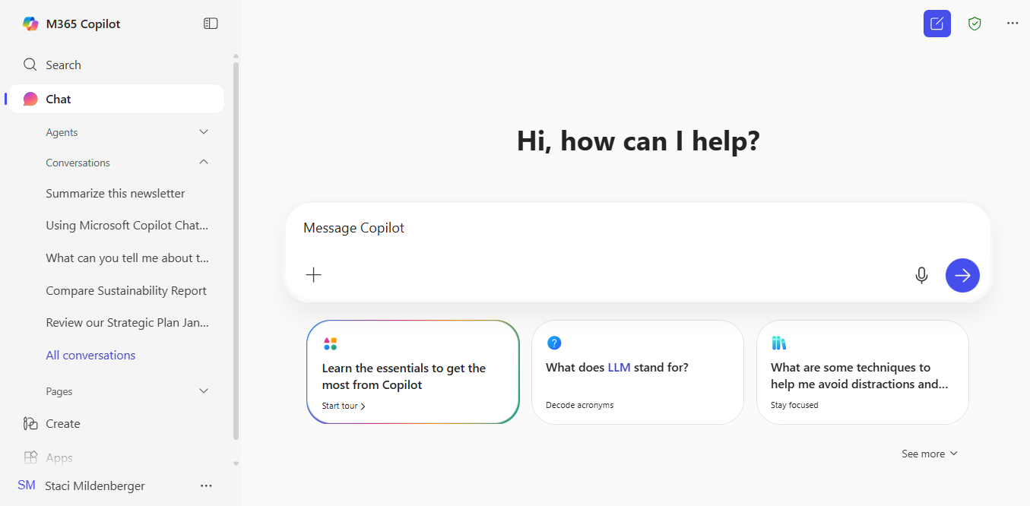
New Copilot Chat UI Coming Soon – be ready!
Start at
M365Copilot.com
Prompt box
Start your conversation here.
Start a new chat button
Clear your past chat and start a new conversation.
Here is a visual tour of new Copilot Chat:
Recent chats
Return to a previous chat to continue the conversation
Send your prompt!
Suggested prompts
If you’re not sure what to ask, try or modify a sample prompt!
Upload files
If you’d like Copilot to source responses from information in specific files, add them here.
Copilot Prompt Gallery
View additional prompt suggestions, including saved prompts.

